Slide 1
Smart Watches, Weka, and Programming Assignment
Sree Deeksha Bethapuri

Slide 2
overview
Smart watches
Wada
Weka
Example

Slide 3
Smartwatch

Slide 4
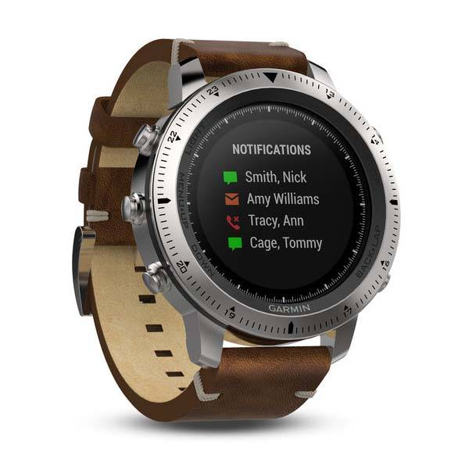
Physical hardware
Sensors
Processor
Memory
Battery
Wireless Communication
Software
Operating system
SensorAPIs
Applications
Data Preprocessing
What is a smartwatch?

Slide 5
Why is it a cyber-physical system?
Human Movement
Physiology
Environment
Accelerometer
Gyroscope
Heartrate
Processor
Signal Processing
Steps
Activity
Heart state
Display
Vibration
Communicatio-n
Physical World
Sensing
Computation
Inference
Feedback
A cyber-physical system integrates computation with processes occurring in the physical world
Notes:
Collection of interacting components

Slide 6
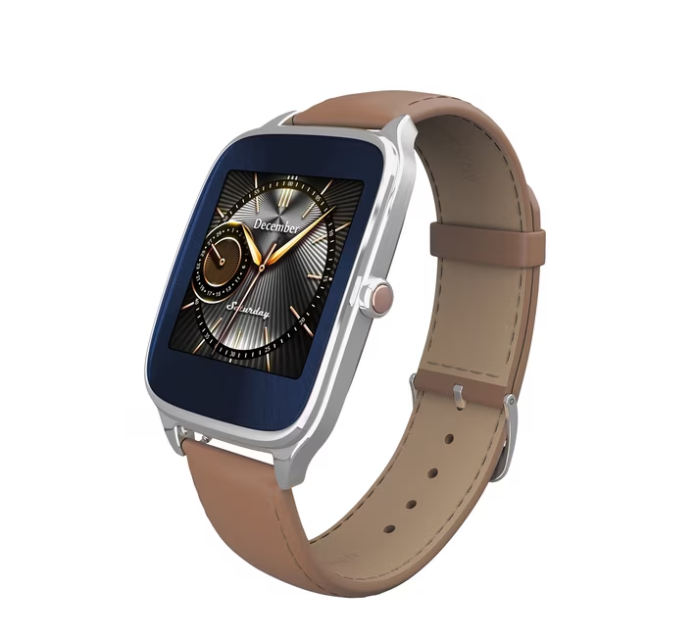
ASUS Zenwatch2
We will use ASUS Zenwatch2 for this class
Projects: Collect data using sensor collection app – wada
Configure the settings
Collect the data
Export the data to the computer and continue the analysis

Slide 7
wada
Talk about the watch and get the WADA slides here

Slide 8

Why do we use wada?
Android wear OS app
Collects sensor data
Lets export the data using android tools
Link to android tools:
https://developer.android.com/tools/releases/platform-tools
Notes:
The watch can sense data; WADA makes that data usable for our experiments.

Slide 9
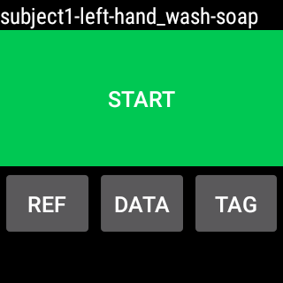
Wada home
Annotations
Start / Stop button:
to start and stop data collection
None_none_none_none
Refresh the display
Brings a new display for data
Brings a new display for setting annotations

Slide 10
CONNECT WATCH TO system
Download android development kit, platform tools
Open cmd
Go to Settings in Watch and set debug to true (in the watch)
Connect the device by using abd devices
This will show the device you just connected.
Once connected, you can use the commands in the next slide to perform several operations.

Slide 11
Quick commands
Check whether the watch is connected and authorized: adb devices
Confirm if wada is installed: adb shell pm list packages | findstr /i wada
Update config: Adb push config.json /sdcard/wada/config/config.json
Check config in the watch: Adb shell cat /sdcard/wada/config/config.json
Restart wada: Adb shell am force-stop edu.virginia.cs.mooncake.wada
View Saved files: Adb shell ls –la /wada/data
Download/ extract files: Adb pull/sdcard/wada/data/FILENAME
MAKE SURE THAT DEBUG IS SET TO TRUE BEFORE RUNNING ADB DEVICES

Slide 12
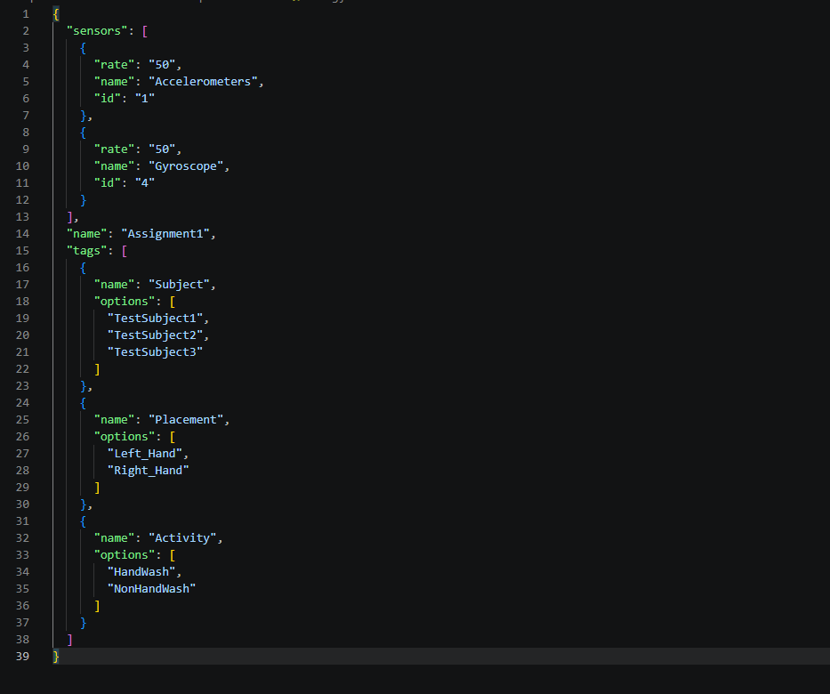
Setting up and Changing the config file
Path to config: /sdcard/wada/config/config.json
Windows side: C:\platform-tools-latest-windows\platform-tools\config.json
Commands: adb push/pull FILE PATH
Inspect: adb shell cat ...
Notes:
The configuration tells WADA what you want to collect and what labels should appear during recording. This confugration is already provided for all of the watches.

Slide 13
Subject + Hand + activity + additional info
Talk about the watch and get the WADA slides here

Slide 14
Wada home after config
Annotations
Start / Stop button:
to start and stop data collection
Subject_Placement_Activity_None
Refresh the display
Brings a new display for data
Brings a new display for setting annotations

Slide 15
annotations
  Subject: Person performing the activity
  Placement: Left/Right hand the watch is on
  Activity: The activity for which data is being collected
  Additional information: Additional information if any.
Subject_Placement_Activity_None
Notes:
Before start collecting data, set appropriate annotations
The selected annotations are shown at the top of Home screen (separated by dashes)

Slide 16
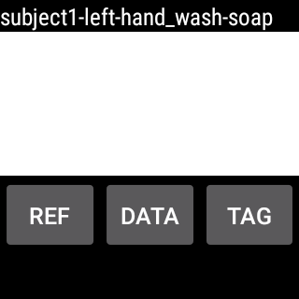
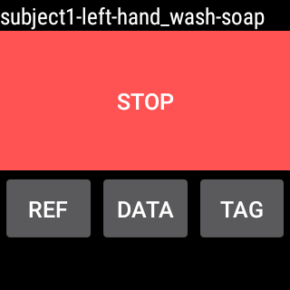
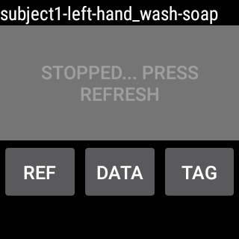
Press Start, and start activity immediately. The button is green when the start option is available
The button becomes white for a moment. Continue activity, no need to look at the watch after pressing the Start (green) button
The button becomes red (Stop option) automatically within 2-3 seconds. When activity is finished, Press the button (red) immediately
The button becomes grey (inactive). Press the refresh button (REF), and it would be green (Start option) again
Data collection
Notes:
Before starting, check that the annotations are selected properly. Annotations changed during datacollection (after start is pressed) are not reflected in the file name (annotations) of current data.
The home screen never sleeps if it is in the foreground. For long term data collection, the app should beclosed (by swiping) . Appropriate button (green/red) appears when the app is opened again.

Slide 17
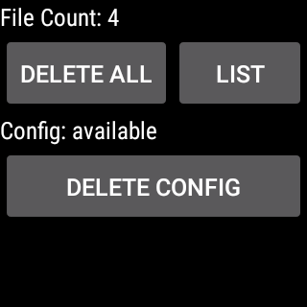
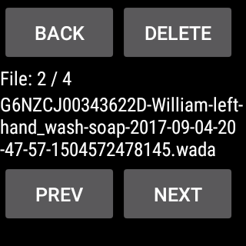
data
You can access the data by clicking List.
You can then add, delete, and export the data as you wish.
File Name

Slide 18
File Name
Format of the file name:
watch_id-subject-hand-activity-additional_info-year-month-day-hour-min-second.wada
Example:
G6NZCJ00343622D -subject1-left-hand_wash-soap-2016-01-19-19-15-11.wada
Note:
year-month-day-hour-min-second : denotes the time when the start button is pressed

Slide 19
Retrieve Data
  To retrieve all the data files from the watch, connect the watch to a computer and put the following command* (on terminal/command line) from the computer.
    adb pull /sdcard/wada/data
  The files would be available in the present working directory of the computer
  If all the files are retrieved to the computer properly, delete the files from the watch.
    * Ensure that the adb command is available. If not, install android SDK

Slide 20
Weka
Notes:
We have collected the data. Now what do we actually do with it?

Slide 21
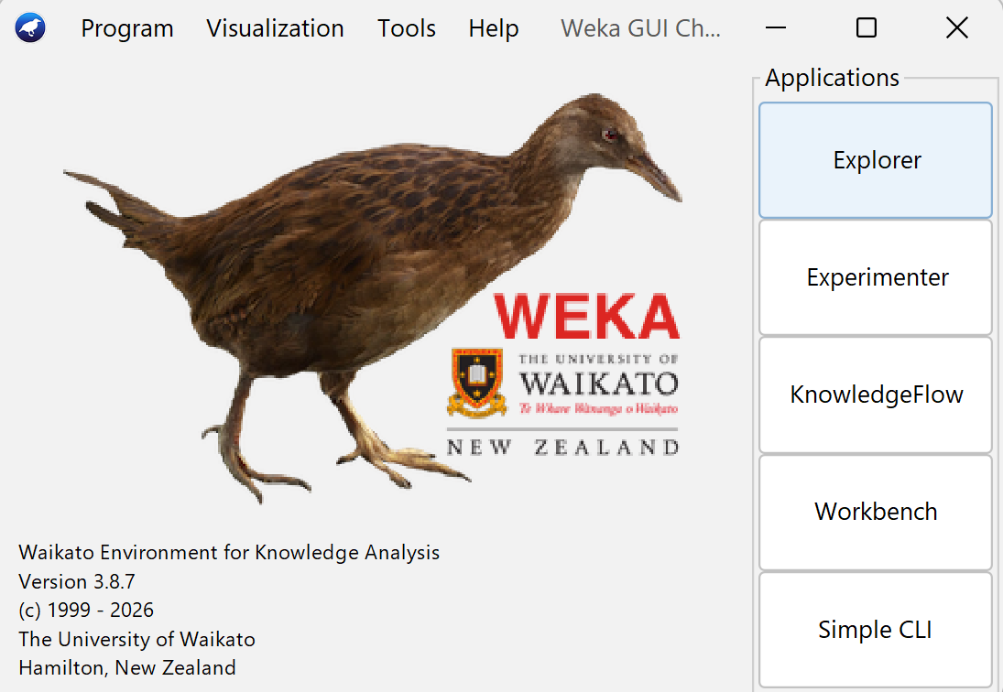
Weka Home Page
Why are we using it?
A GUI for quickly trying classical ML workflows.
Inspect->train->evaluate
download weka: https://waikato.github.io/weka-wiki/downloading_weka/
A machine learning toolkit developed at the University of Waikato in 1993
Notes:
This homepage is the GUI chooser. WEKA gives us several interfaces for what we want to do. Experimenter is useful for systematically comparing models, Knowledge flow lets us visually construct workflows, and there is also a command line interface. We aree going to be using Explorer, since it gives us everything we need quickly to inspect a dataset, train a model, and evaluate the results. but feel free to play around.
native bird of newzealand
Waikato environment for knowledge analysis – also named after the new zealand weka bird
1990

Slide 22
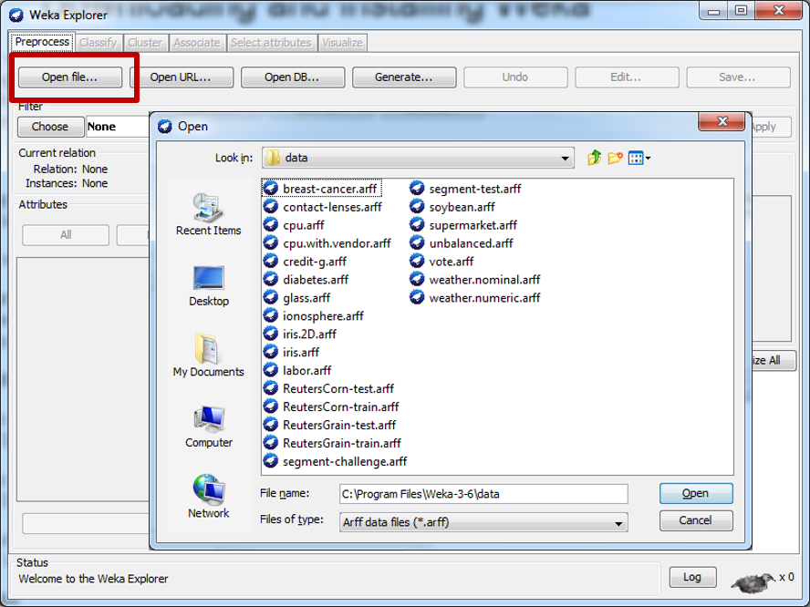
Loading dataset
Preprocess -> Openfile -> select csv or arff
Weka can work with both of them
The main difference between them is the header format.
Check the ARFF files present in the Weka folder for examples.
Notes:
This is the main weka explorer interface. We start in Preprocess, where we load and inspect our data. Once the dataset is loaded WEKA shows us the number of instances, the attributes, and information about each feature. From here, we can visualize the data and then move to classify to train a model.

Slide 23
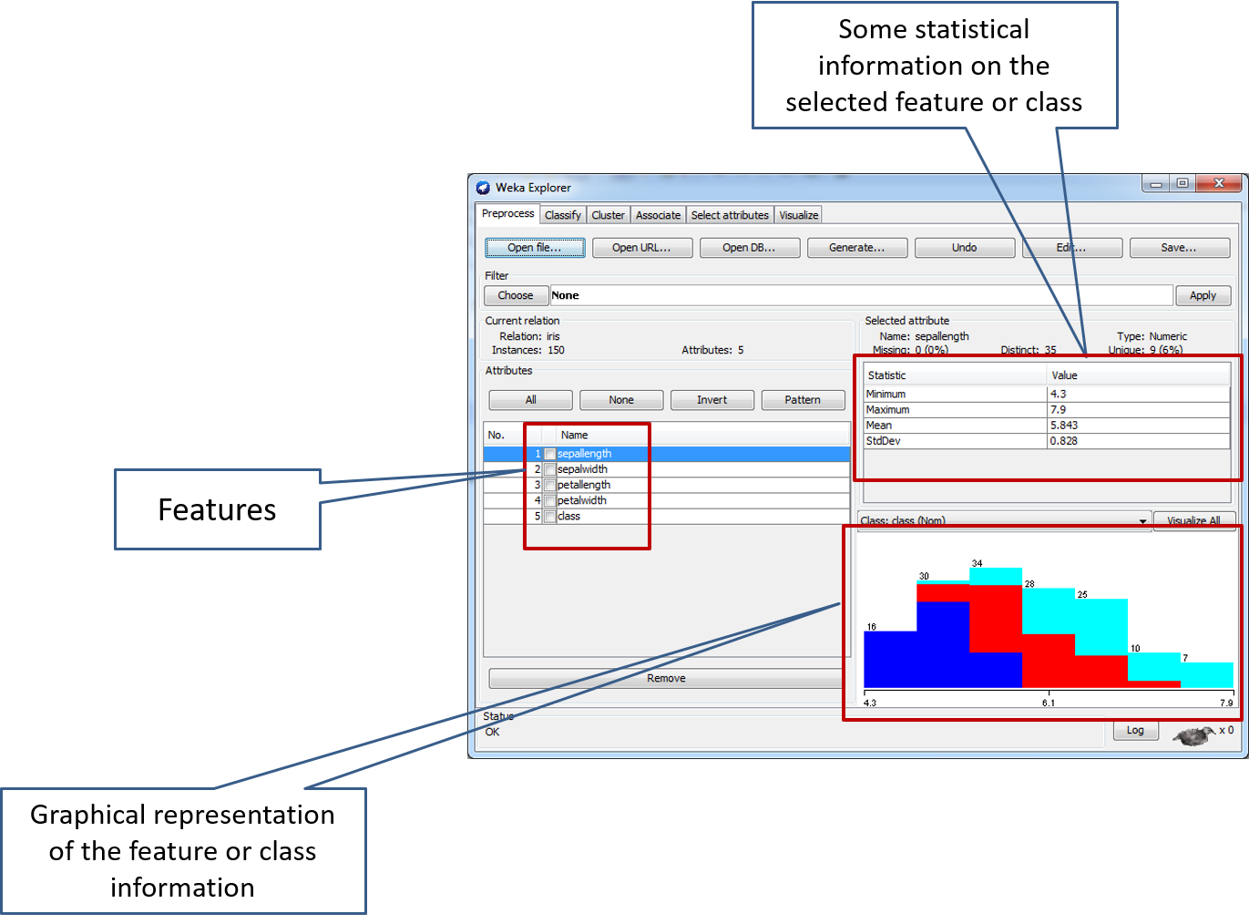
Inspecting dataset

Slide 24
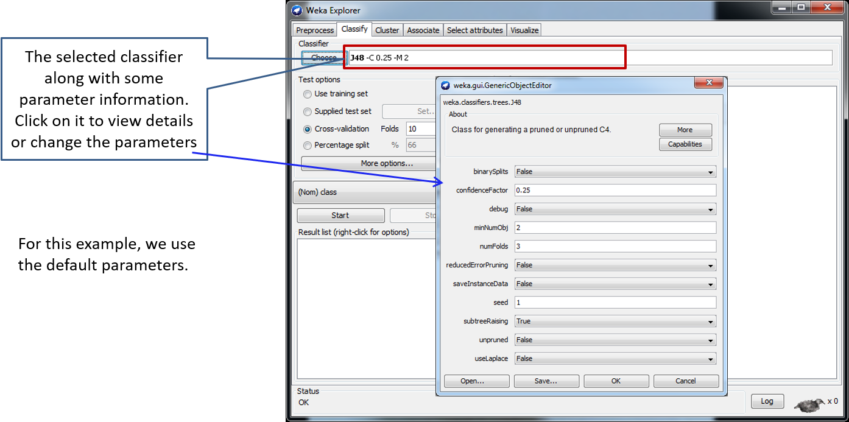
Running the classifier

Slide 25
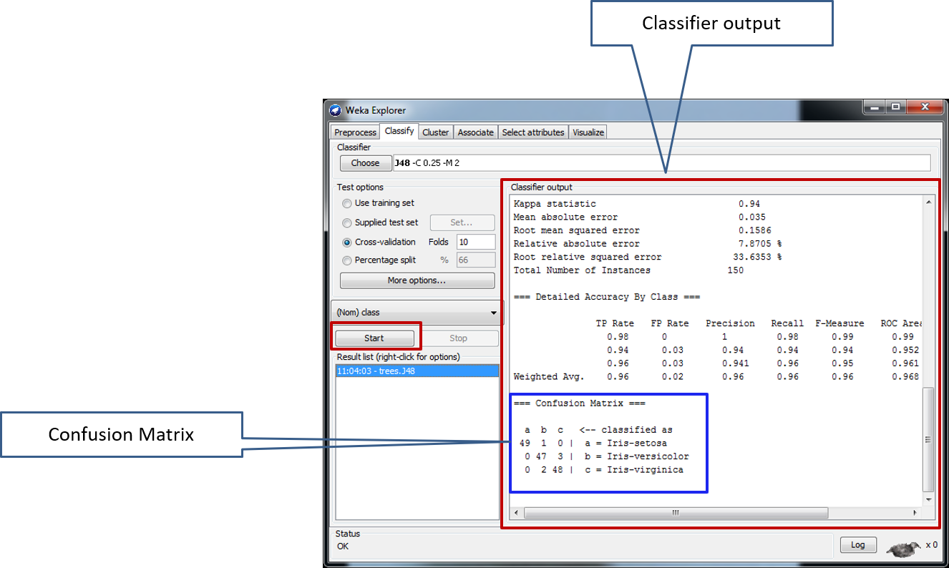
Output

Slide 26
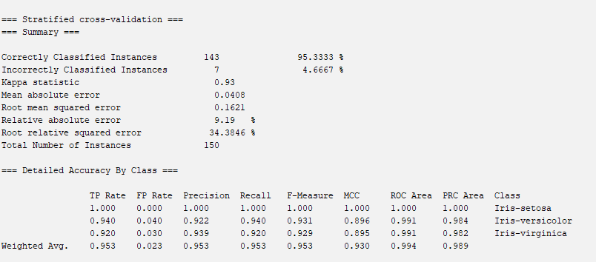
Output Summary
TP – True positive
FP - False positive
MCC – Matthew correlation coeeficient
ROC Area – Receiver operating characteristic
PRC Precision recall curve
We want everything to be higher except FP and All errors

Slide 27
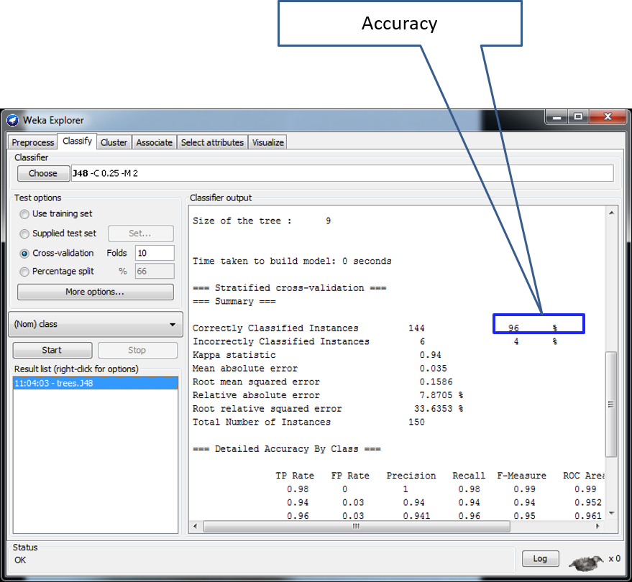
Output

Slide 28
demo

Slide 29
important
Save everything (data and code) from Project 1 as you will build upon it for Project 2
Upload only 1 copy of results under any team member name – use the same name for both Projects

